Slide 1
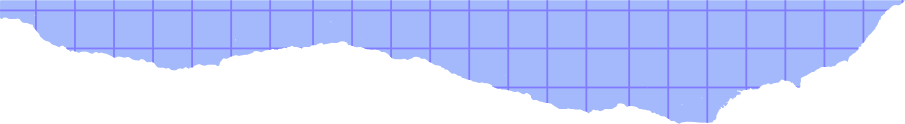
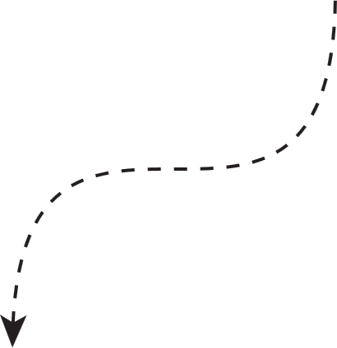



By JOTIKA HABLANI , BHOOMIKA SABLANI AND SUNAINA MOTWANI
DATA
STRUCTURES

Slide 2

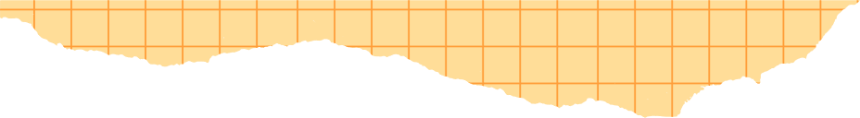



Intro To Graph
Terminologies
Types
Graph Representation Techniques
Application/Importance
Graph Traversal
Diff Between Dfs And Bfs
Dfs Intro/Concept
- Characteristic
Working Of Dfs
Algothrim+Program Of Dfs.
Agenda

Slide 3

→Introduction of graph
Graph is A example of non-linear data structure.
Graph is the collection of data items called node which are connected to each other by the help of edge.
D
A
Node/Vertex
C
Egdes
E
B

Slide 4
# Representation of graph
→ A graph ( G ) can be represented in ordered pairs.
Example g(v,e)
- V = number of vertices
- E = number of edges
- Vertex : a vertex is a point or node in a graph that represents an entity.
- Edge : an edge is a line that connects two vertices in a graph.

Slide 5
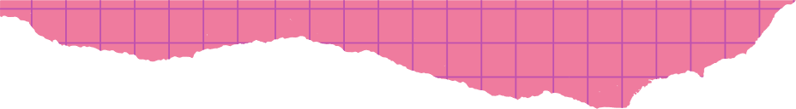
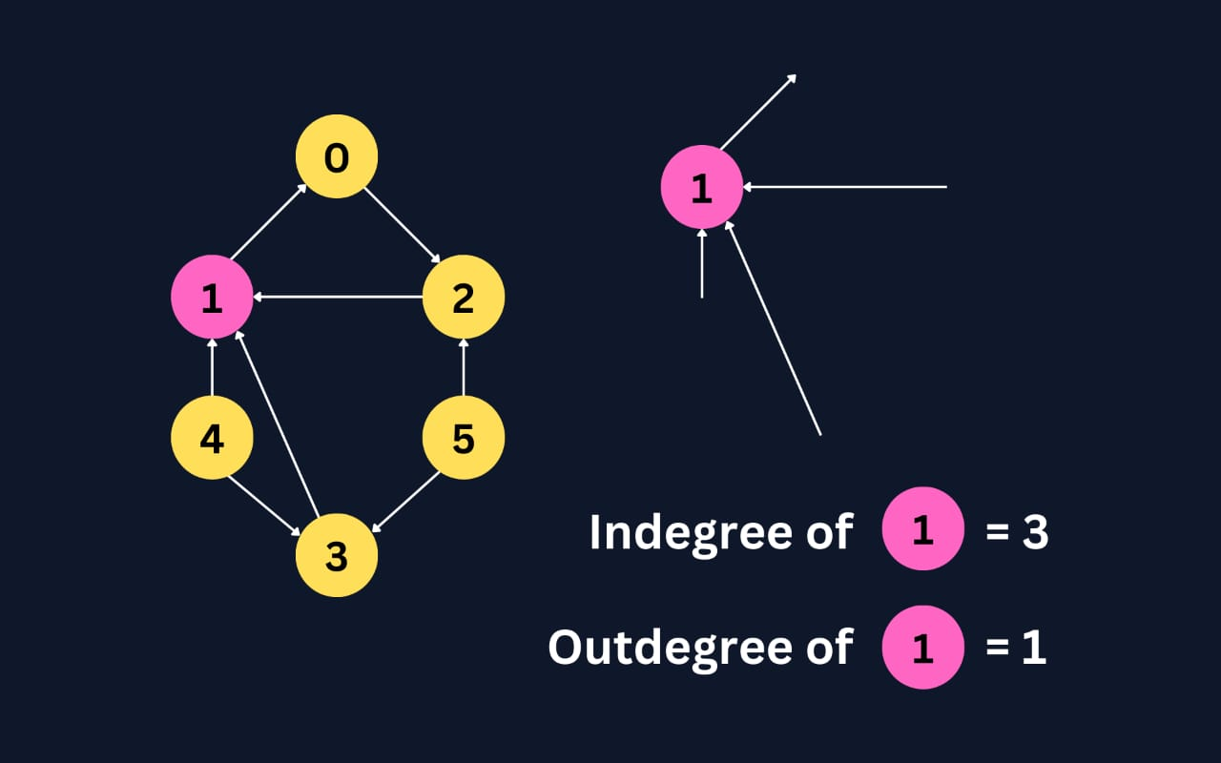
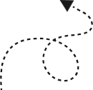
→Terminologies Of Graph
1 - Degree : the number of edges connected to A vertex.
Example: in a—b—c, vertex *b* has degree 2.
In-degree / out-degree: in a directed graph.
→ *In-degree* means edges coming into a vertex, and *out-degree* means edges going out.

Slide 6
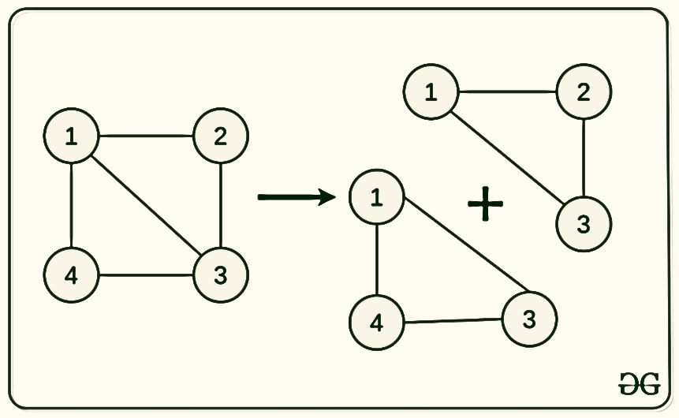
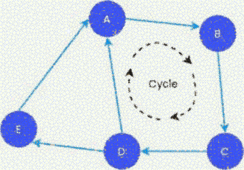
→Terminologies Of Graph
2- Path : A sequence of vertices connected by edges.
3- Cycle : A path that starts and ends at the same vertex.

Slide 7
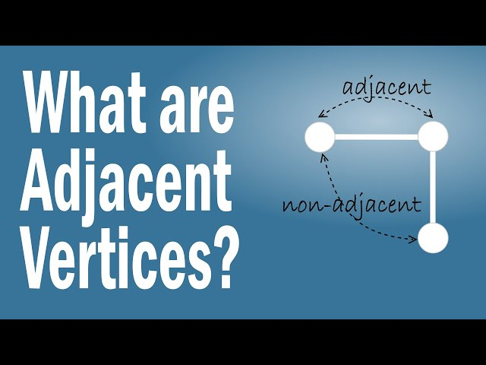
→Terminologies Of Graph
4- Adjacent Vertices : Two vertices that are directly connected by an edge.
Example: In A — B — C, A and B are *adjacent vertices*.

Slide 8
Directed
Un - directed
Graph
Weighted
Un - weighted
Types
Cyclic
Acyclic

Slide 9


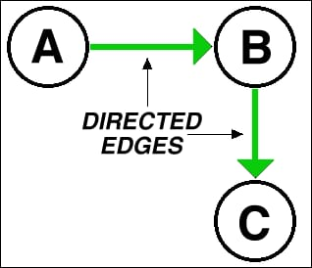
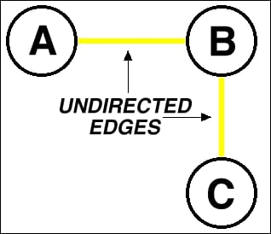
→Types Of Graph
*Directed Graph* – Edges have direction.
🔹 Example: A → B (one-way road).
2. *Undirected Graph* – Edges have no direction.
🔹 Example: A — B (two-way road).

Slide 10
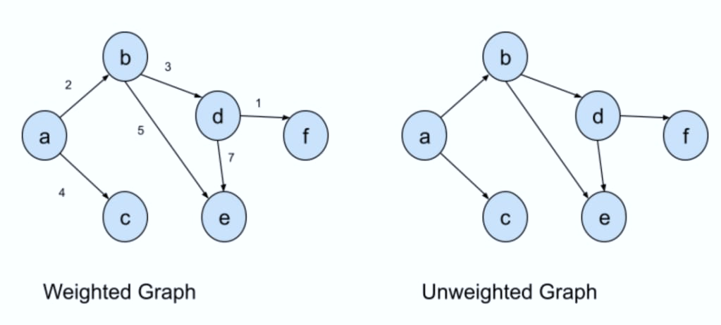
→Types Of Graph
3. *Weighted Graph* – Edges have weights or costs.
🔹 Example: A —5— B (distance = 5 km).
4. *Unweighted Graph* – No weights on edges.
🔹 Example: A — B — C (just connections).

Slide 11
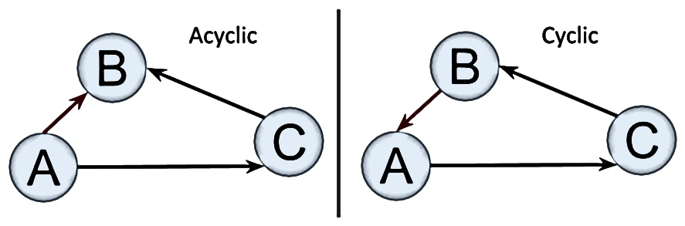
→Types Of Graph
5. *Cyclic Graph* – Has a cycle.
🔹 Example: A → B → C → A.
6. *Acyclic Graph* – No cycle.
🔹 Example: A → B → C (no return path).

Slide 12


→Ways To Represent A Graph In DataStructures
1 - Adjacency List
2 - Adjacency matrix
Adjacency List is a way to store a graph.
For every node, we write the list of nodes it is connected to.
→Uses less memory.
→Good for graphs with few connections.
Adjacency Matrix is a table (2D array) that shows connections.
Rows and columns are the nodes.
If two nodes are connected, we write 1, otherwise 0.
→Uses more memory.
→Good for graphs with many connections.

Slide 13
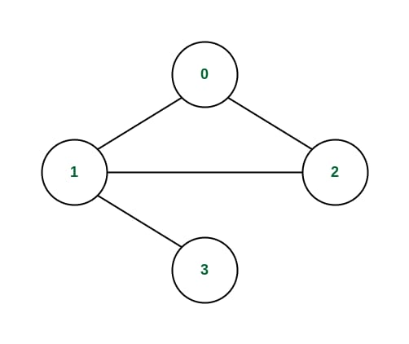
1- Adjacency List
0 1 2 3
1
2
0
2
3
Linked List
0
1
1

Slide 14
2- Adjacency matrix
→ If two nodes are connected, we write 1, otherwise 0.
 | 0 | 1 | 2 | 3
0 | 0 | 1 | 1 | 0
1 | 1 | 0 | 1 | 1
2 | 1 | 1 | 0 | 0
3 | 0 | 1 | 0 | 0

Slide 15


1
Social Networks
Example: Facebook, Instagram, WhatsApp.
People = nodes Friendships or followers = edges
→Graphs help find mutual friends, suggest people you may know, or show connections between users.
→Graph Application
Graph applications” means where we use graphs in real life or computer science
— basically how graphs help us solve problems.
2
Google Maps
Example: Cities or locations = nodes
Roads = edges.
→ Graph algorithms find the shortest path (like fastest route from home to school).
3
Computer Networks
Computers = nodes
Cables/connections = edges.
Graphs help design and manage the Internet, showing how computers are linked.

Slide 16







#Ex Of Application

Slide 17


→Graph Traversal
Graph traversal refers to the process of visiting (checking and updating ) each vertex(node) in a graph.
Sequence of steps known as "graph travesal algothrim" can be used to traverse a graph .
Two algothrims of graph travesal are:-
- Breadth first search (BFS)
- Depth first search (DFS)

Slide 18

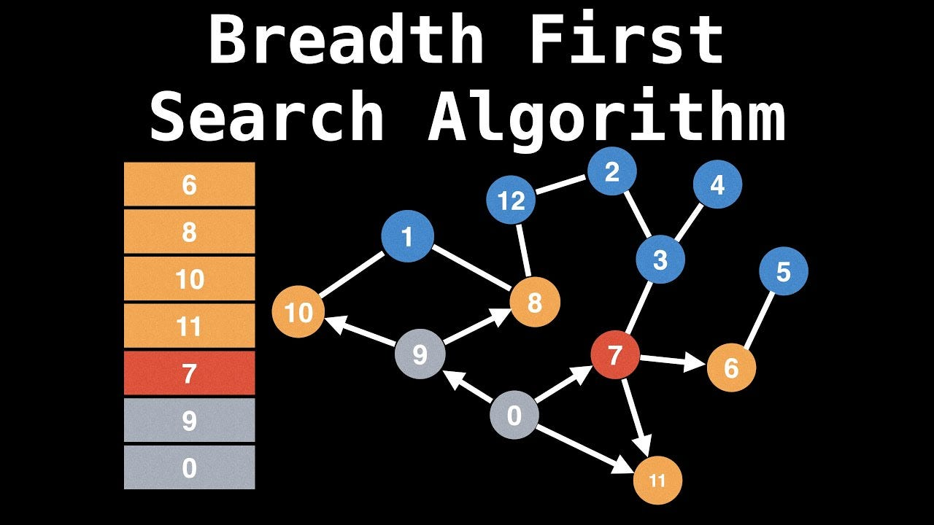
→Short Intro To Bfs Before Dfs
- BFS (breadth first search)
BFS means start from one place and visit all nearby places first, then move to the next level of places.
BFS = Go level by level.
Queue data structures is used in this.

Slide 19


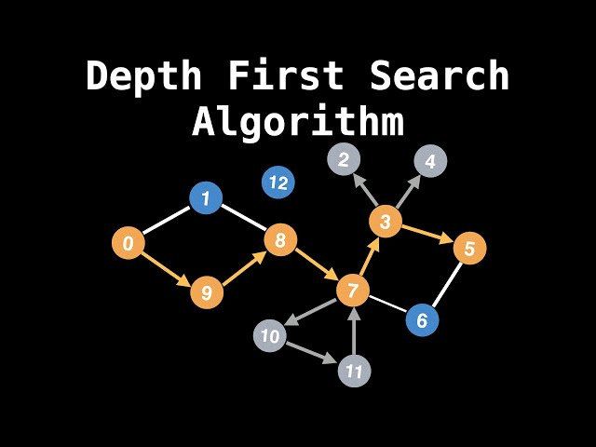

-Depth First Search(DFS)
→Intro to DFS
DFS means start from one place and keep going deep until you can’t go further, then go back and try another path.
DFS explores deep first.

Slide 20

→Characteristics Of DFS
Goes Deep First as possible:
DFS explores one path completely before moving to another
Uses Stack or Recursion:
It uses a stack (or recursion) to remember visited nodes.
Graph (Adjacency List or Matrix)
Visited array (to mark visited nodes)

Slide 21
→Characteristics Of DFS
Time Complexity
O(V + E)
(V = number of vertices, E = number of edges)
Backtracking = When stuck, go back and try another path.
Uninformed search technique .

Slide 22
- Depth First Search
#Working
Start by putting any one of the graphs vertices on top of a stack.
Take the top item of the stack and add it to the visited list.
Create a list of that vertex's adjacent nodes and the one's which are not in the visited list to top of the stack.
Keep repeating steps 2 and 3 until the stack is empty.

Slide 23
#ËX OF WORKING
→ Choosing 0
0
1
0
Visited List : 0
3
2
4
0
Stack
5
6

Slide 24
#ËX OF WORKING
→ Choosing 1
0
1
1
,1
Visited List : 0
3
2
1
4
0
Stack
5
6

Slide 25
#ËX OF WORKING
→ Choosing 2
2
0
1
Visited List : 0,1
,2
3
2
2
1
4
0
Stack
5
6

Slide 26
#ËX OF WORKING
→ Choosing 3
3
0
1
,3
Visited List : 0,1 , 2
3
3
2
2
1
4
0
Stack
5
6

Slide 27
#ËX OF WORKING
→ Choosing 4
4
1
0
4
,4
Visited List : 0,1 , 2 , 3
3
3
2
2
1
4
0
Stack
5
6

Slide 28
#ËX OF WORKING
→ Choosing 5
5
1
0
5
4
Visited List : 0,1 , 2 , 3 , 4
,5
3
3
2
2
1
4
0
Stack
5
6

Slide 29
#ËX OF WORKING
→ BACKTRACKING
0
1
5
4
Visited List : 0,1 , 2 , 3
,4 , 5
3
3
2
2
1
4
0
Stack
5
6

Slide 30
#ËX OF WORKING
→ Choosing 6
6
1
0
6
4
,6
Visited List : 0,1 , 2 , 3 , 4, 5
3
3
2
2
1
4
0
Stack
5
6

Slide 31
#ËX OF WORKING
→ BACKTRACKING
0
1
6
4
Visited List : 0,1 , 2 , 3
,4 , 5 , 6
3
3
2
2
1
4
0
Stack
5
6

Slide 32
#ËX OF WORKING
→ BACKTRACKING
0
1
4
Visited List : 0,1 , 2 , 3
,4 , 5 , 6
3
3
2
2
1
4
0
Stack
5
6

Slide 33
#ËX OF WORKING
→ BACKTRACKING
0
1
Visited List : 0,1 , 2 , 3
,4 , 5 , 6
3
3
2
2
1
4
0
Stack
5
6

Slide 34
#ËX OF WORKING
→ BACKTRACKING
0
1
Visited List : 0,1 , 2 , 3
,4 , 5 , 6
3
2
2
1
4
0
Stack
5
6

Slide 35
#ËX OF WORKING
→ BACKTRACKING
0
1
Visited List : 0,1 , 2 , 3
,4 , 5 , 6
3
2
1
4
0
Stack
5
6

Slide 36
#ËX OF WORKING
→ BACKTRACKING
0
1
Visited List : 0,1 , 2 , 3
,4 , 5 , 6
3
2
4
0
Stack
5
6

Slide 37
#ALGOTHRIM OF DFS Using Adjacency Matrix
v = is the name of visited array.
a = is the name of adjacency matrix.
DFS = is the name of the function.
i = is the vertex from which you want to start graph traversal.
STEP 1 – FUNCTION DFS(i).
STEP 2 – WRITE (i).
STEP 3 – SET v[i] = 1.
STEP 4 – REPEAT for j = 0 to 6.
STEP 5 - IF (a[i][j] == 1 && v[j] == 0) THEN
CALL DFS(j).
STEP 6 – EXIT/RETURN.
END OF IF STRUCTURE , STEP 4 , STEP 1

Slide 38
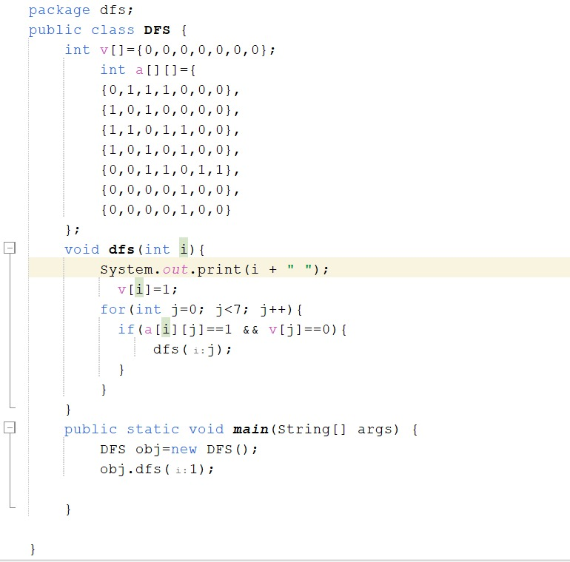
#PROGRAM OF DFS
Output of the code : 1
0
2
3
4
5
6

Slide 39
THANK
YOU!

